Slide 1
To replace with my own drawing

Slide 2
CSS342 Data Structures, Algorithms, and Discrete Mathematics (I)

Slide 3
More on Recursion

Slide 4

Recursive Summary
Solution ← Solution of a subproblem
$sum\left(n\right)=a\left[n−1\right]+sum(n−1)$
Depth First Visit
head
8
3
2
9
5
6
null
Visit

Slide 5

Code along
https://github.com/pdgetrf/recursion-examples

Slide 6
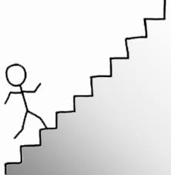
Recursion:
You are climbing a staircase.
It takes n steps to reach to the top.
Each time you can either climb 1 or 2 steps.
In how many distinct ways can you climb to the top?

Slide 7
1
n=1
0→1
F(1) = 1
0
0→1→2
N=2
F(2) = 2
0→2

Slide 8
0→1→3
3
2
N=3
0→1→2→3
1
0
0→2→3

Slide 9
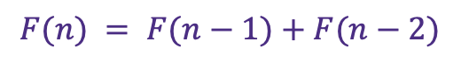
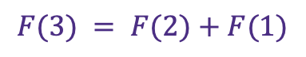
0→1→3
F(1)
3
2
N=3
0→1→2→3
1
F(2)
0
0→2→3
$$F(3) = F(2)+F(1)$$
$$F(n) = F(n−1)+F(n−2)$$

Slide 10
A Search Problem (sorted array)
Target: 14
Binary search
1
3
5
7
9
10
12
12
14
14
18

Slide 11
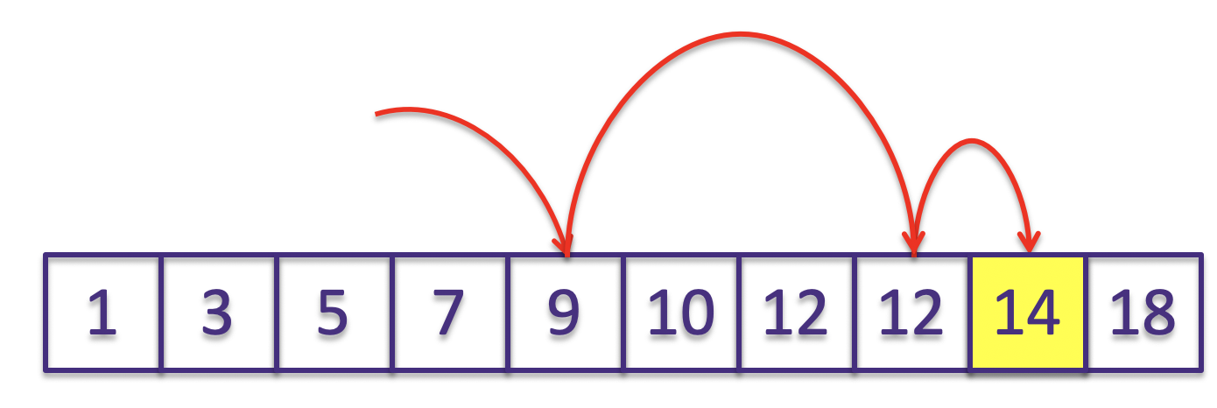
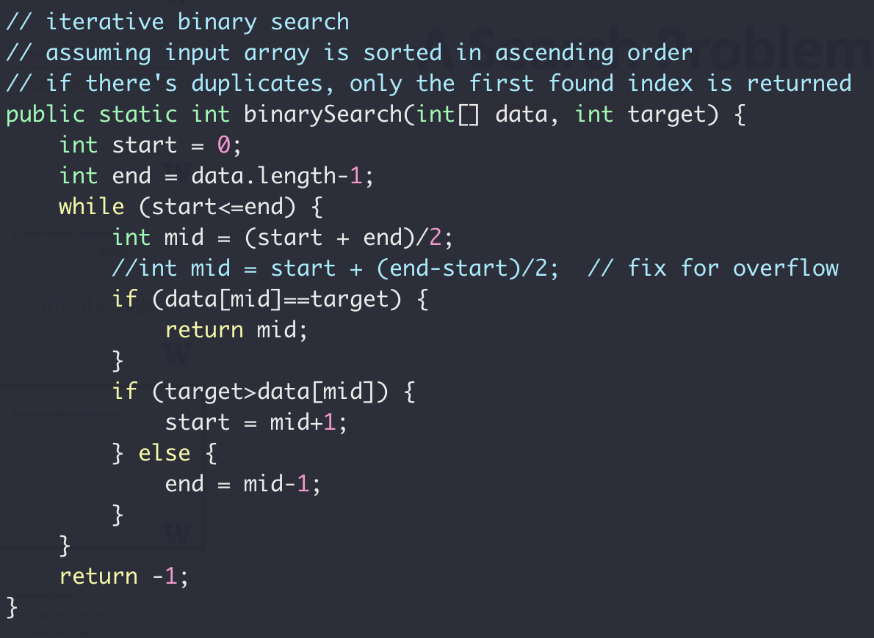
A Search Problem (sorted array)
Iteratively

Slide 12
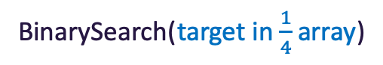
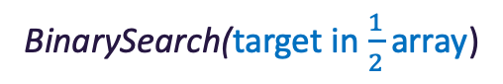
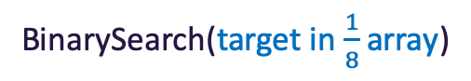
Recursive Binary Search
BinarySearch(target in whole array)
BinarySearch(target in $\frac{1}{2}$array)
BinarySearch(target in $\frac{1}{4}$array)
Target: 12
BinarySearch(target in $\frac{1}{8}$array)
1
3
5
7
9
10
12
12
14
18

Slide 13
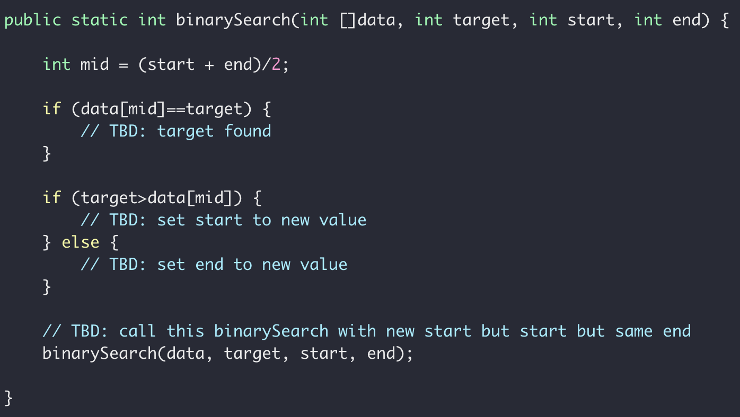
Recursive Binary Search

Slide 14
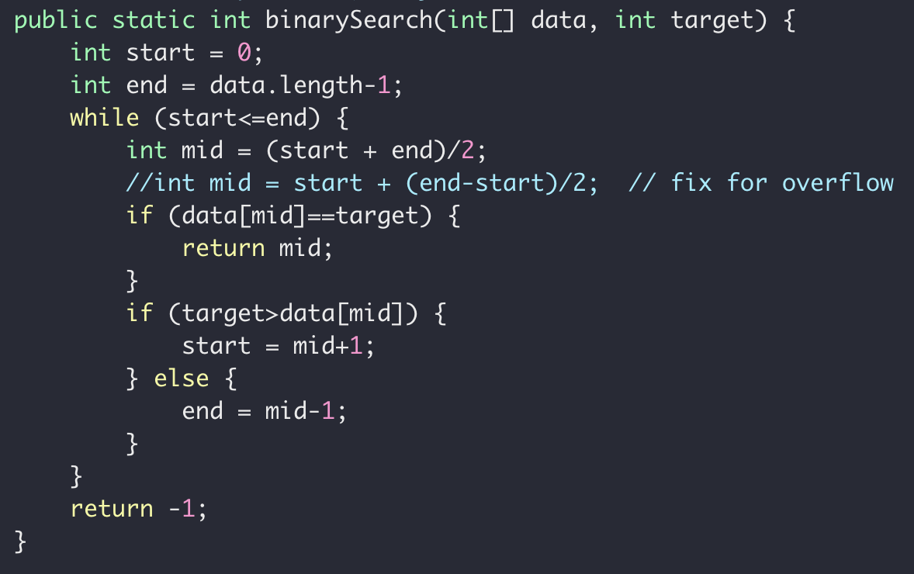
Recursive Binary Search
Iterative
Recursive

Slide 15
Permutation

Slide 16
Sort List

Slide 17
head
8
3
2
9
1
6
null

Slide 18
1. Split into two halves
head
8
3
2
null
head
9
1
6
null

Slide 19
2. Sort both halves
head
2
3
8
null
head
9
1
6
null

Slide 20
head
2
3
8
null
head
1
6
9
null

Slide 21
head
2
3
8
null
head
1
6
9
null

Slide 22
3. Merge back into one list
head
2
3
8
null
head
1
6
9
null

Slide 23
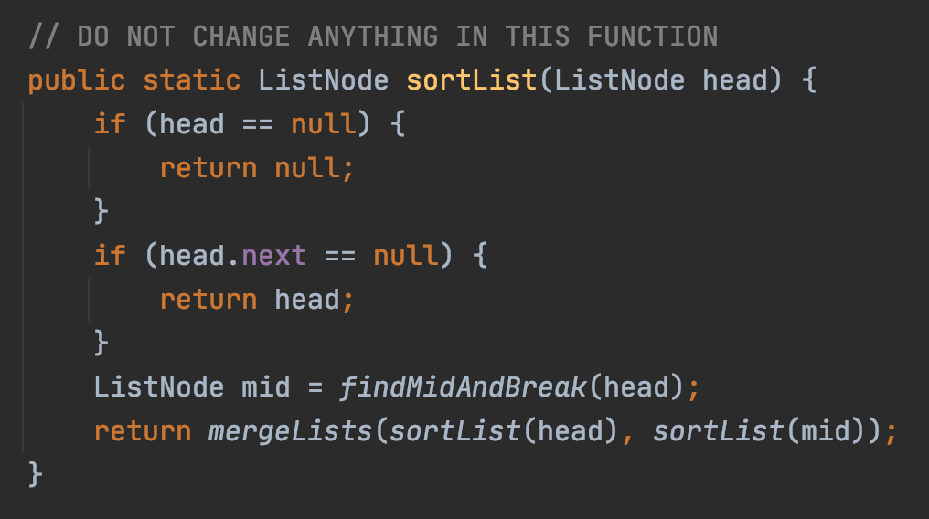
1. Split into two halves
2. Sort both halves
3. Merge back into one list

Slide 24
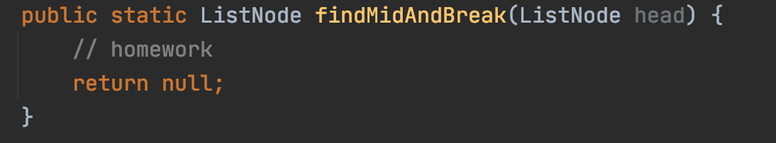
Split into two halves
head
8
3
2
9
1
6
null

Slide 25

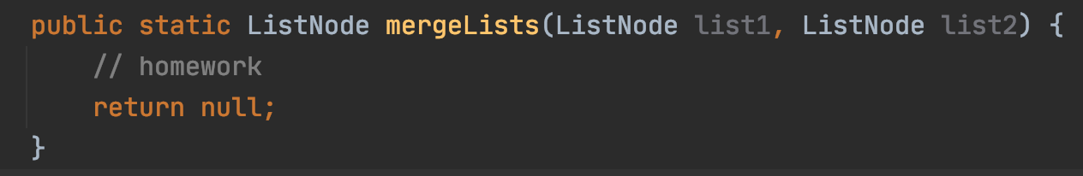
Merge back into one list
head
2
3
8
null
head
1
6
9
null
head

Slide 26
Another Demo For Sort List

